Slide 1


Slide 2
Open 05-Data-Types.Rmd

Slide 3
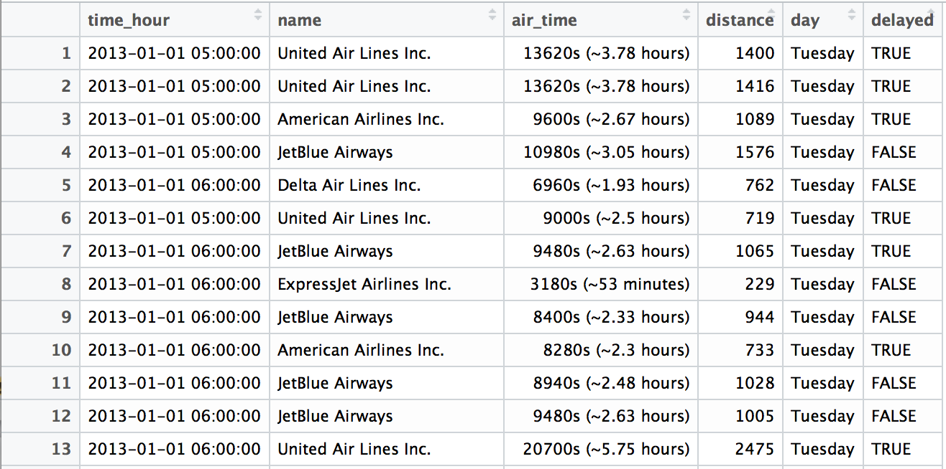
Quiz
What types of data are in this data set?

Slide 4

(Applied) Data Science
Visualize
Import
Tidy
Model
Communicate
Transform
Program
CC BY-SA RStudio

Slide 5
(Applied) Data Science
Visualize
Import
Tidy
Model
Communicate
Transform
Program
CC BY-SA RStudio

Slide 6
Logicals

Slide 7
Logicals
R's data type for boolean values (i.e. TRUE and FALSE).
typeof(TRUE)
## "logical"
typeof(FALSE)
## "logical"
typeof(c(TRUE, TRUE, FALSE))
## "logical"
CC BY-SA RStudio

Slide 8
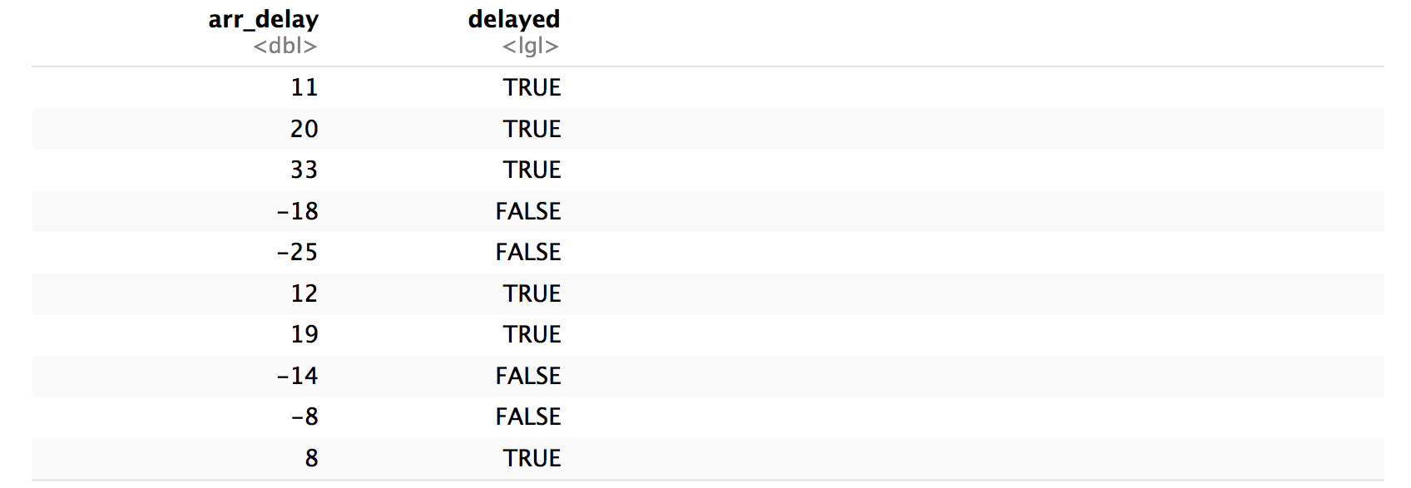
flights %>%
mutate(delayed = arr_delay > 0) %>%
select(arr_delay, delayed)
CC BY-SA RStudio

Slide 9
Warm Up
Did you fly here?
Did your flight arrive late?

Slide 10
flights %>%
mutate(delayed = arr_delay > 0) %>%
select(arr_delay, delayed)
Can we compute the proportion of NYC flights that arrived late?
CC BY-SA RStudio

Slide 11
Most useful skills
Math with logicals
CC BY-SA RStudio

Slide 12
Math
When you do math with logicals, TRUE becomes 1 and FALSE becomes 0.
CC BY-SA RStudio

Slide 13
Math
When you do math with logicals, TRUE becomes 1 and FALSE becomes 0.
The sum of a logical vector is the count of TRUEs
sum(c(TRUE, FALSE, TRUE, TRUE))
## 3
CC BY-SA RStudio

Slide 14
Math
When you do math with logicals, TRUE becomes 1 and FALSE becomes 0.
The sum of a logical vector is the count of TRUEs
sum(c(TRUE, FALSE, TRUE, TRUE))
## 3
The mean of a logical vector is the proportion of TRUEs
mean(c(1, 2, 3, 4) < 4)
## 0.75
CC BY-SA RStudio

Slide 15
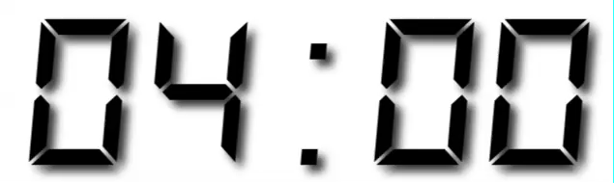
Your Turn 1
Use flights to create delayed, a variable that displays whether a flight was delayed (arr_delay > 0).
Then, remove all rows that contain an NA in delayed.
Finally, create a summary table that shows:
How many flights were delayed
What proportion of flights were delayed

Slide 16
flights %>%
mutate(delayed = arr_delay > 0) %>%
drop_na(delayed) %>%
summarise(total = sum(delayed), prop = mean(delayed))
## # A tibble: 1 × 2
## total prop
## <int> <dbl>
## 1 133004 0.4063101
CC BY-SA RStudio

Slide 17
Strings

Slide 18
(character) strings
Anything surrounded by quotes(") or single quotes(').
> "one"
> "1"
> "one’s"
> '"Hello World"'
> "foo
+
+
+ oops. I’m stuck in a string."
CC BY-SA RStudio

Slide 19

Warm Up
Decide in your group:
Are boys names or girls names more likely to end in a vowel?

Slide 20
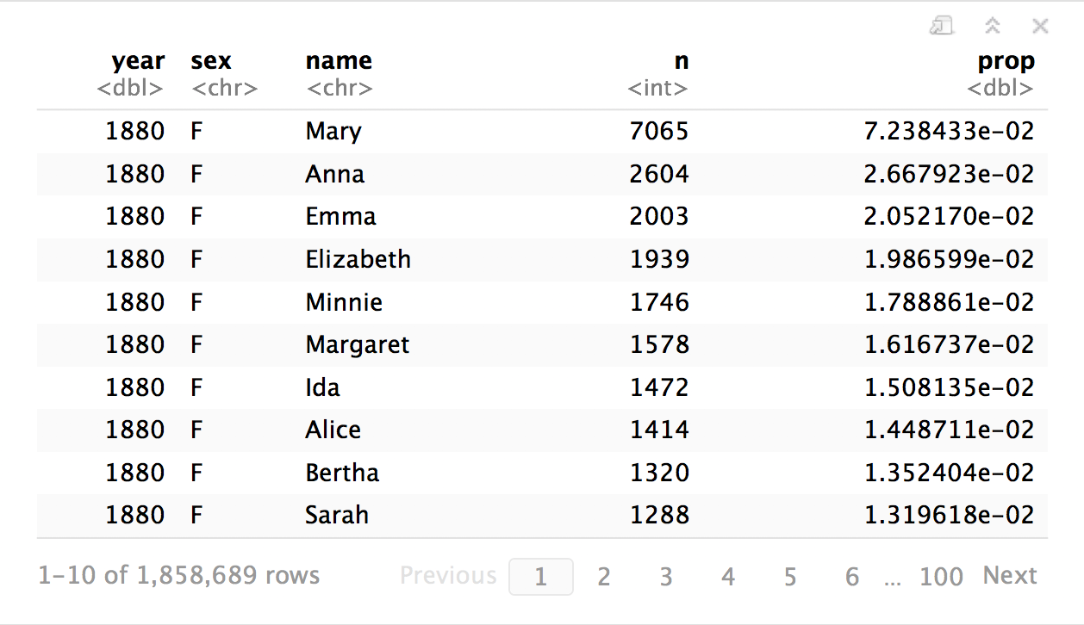

babynames
How can we build the proportion of boys and girls whose name ends in a vowel?
CC BY-SA RStudio

Slide 21
Most useful skills
How to extract/ replace substrings
How to find matches for patterns
Regular expressions
CC BY-SA RStudio

Slide 22

stringr
Simple, consistent functions for working with strings.
# install.packages("tidyverse")
library(stringr)
CC BY-SA RStudio

Slide 23
install.packages("tidyverse")
library("tidyverse")
does the equivalent of
does the equivalent of
install.packages("ggplot2")
install.packages("dplyr")
install.packages("tidyr")
install.packages("readr")
install.packages("purrr")
install.packages("tibble")
install.packages("hms")
install.packages("stringr")
install.packages("lubridate")
install.packages("forcats")
install.packages("DBI")
install.packages("haven")
install.packages("httr")
install.packages("jsonlite")
install.packages("readxl")
install.packages("rvest")
install.packages("xml2")
install.packages("modelr")
install.packages("broom")
library("ggplot2")
library("dplyr")
library("tidyr")
library("readr")
library("purrr")
library("tibble")
CC BY-SA RStudio

Slide 24
install.packages("tidyverse")
library("tidyverse")
does the equivalent of
does the equivalent of
install.packages("ggplot2")
install.packages("dplyr")
install.packages("tidyr")
install.packages("readr")
install.packages("purrr")
install.packages("tibble")
install.packages("hms")
install.packages("stringr")
install.packages("lubridate")
install.packages("forcats")
install.packages("DBI")
install.packages("haven")
install.packages("httr")
install.packages("jsonlite")
install.packages("readxl")
install.packages("rvest")
install.packages("xml2")
install.packages("modelr")
install.packages("broom")
library("ggplot2")
library("dplyr")
library("tidyr")
library("readr")
library("purrr")
library("tibble")
CC BY-SA RStudio

Slide 25
str_sub()
Extract or replace portions of a string with str_sub()
str_sub(string, start = 1, end = -1)
string(s) to manipulate
position of first character to extract within each string
position of last character to extract within each string
CC BY-SA RStudio

Slide 26
Quiz
What will this return?
str_sub("Garrett", 1, 2)

Slide 27
Quiz
What will this return?
str_sub("Garrett", 1, 2)
"Ga"

Slide 28
Quiz
What will this return?
str_sub("Garrett", 1, 1)

Slide 29
Quiz
What will this return?
str_sub("Garrett", 1, 1)
"G"

Slide 30
Quiz
What will this return?
str_sub("Garrett", 2)

Slide 31
Quiz
What will this return?
str_sub("Garrett", 2)
"arrett"

Slide 32
Quiz
What will this return?
str_sub("Garrett", -3)

Slide 33
Quiz
What will this return?
str_sub("Garrett", -3)
"ett"

Slide 34
Quiz
What will this return?
g <- "Garrett"
str_sub(g, -3) <- "eth"
g

Slide 35
Quiz
What will this return?
g <- "Garrett"
str_sub(g, -3) <- "eth"
g
"Garreth"

Slide 36
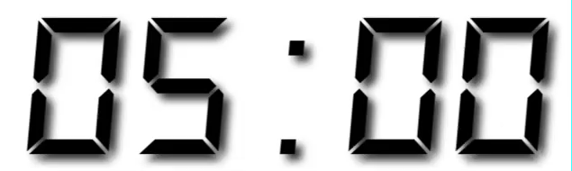
Your Turn 2
In your group, fill in the blanks to:
Isolate the last letter of every name
and create a logical variable that displays whether the last letter is one of "a", "e", "i", "o", "u", or "y".
Use a weighted mean to calculate the proportion of children whose name ends in a vowel (by year and sex)
and then display the results as a line plot.

Slide 37
babynames %>%
mutate(last = str_sub(name, -1),
vowel = last %in% c("a", "e", "i", "o", "u", "y")) %>%
group_by(year, sex) %>%
summarise(p_vowel = weighted.mean(vowel, n)) %>%
ggplot() +
geom_line(mapping = aes(year, p_vowel, color = sex))
CC BY-SA RStudio

Slide 38
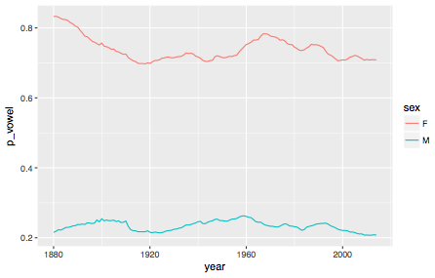
Proportion of names that end in a vowel
CC BY-SA RStudio

Slide 39
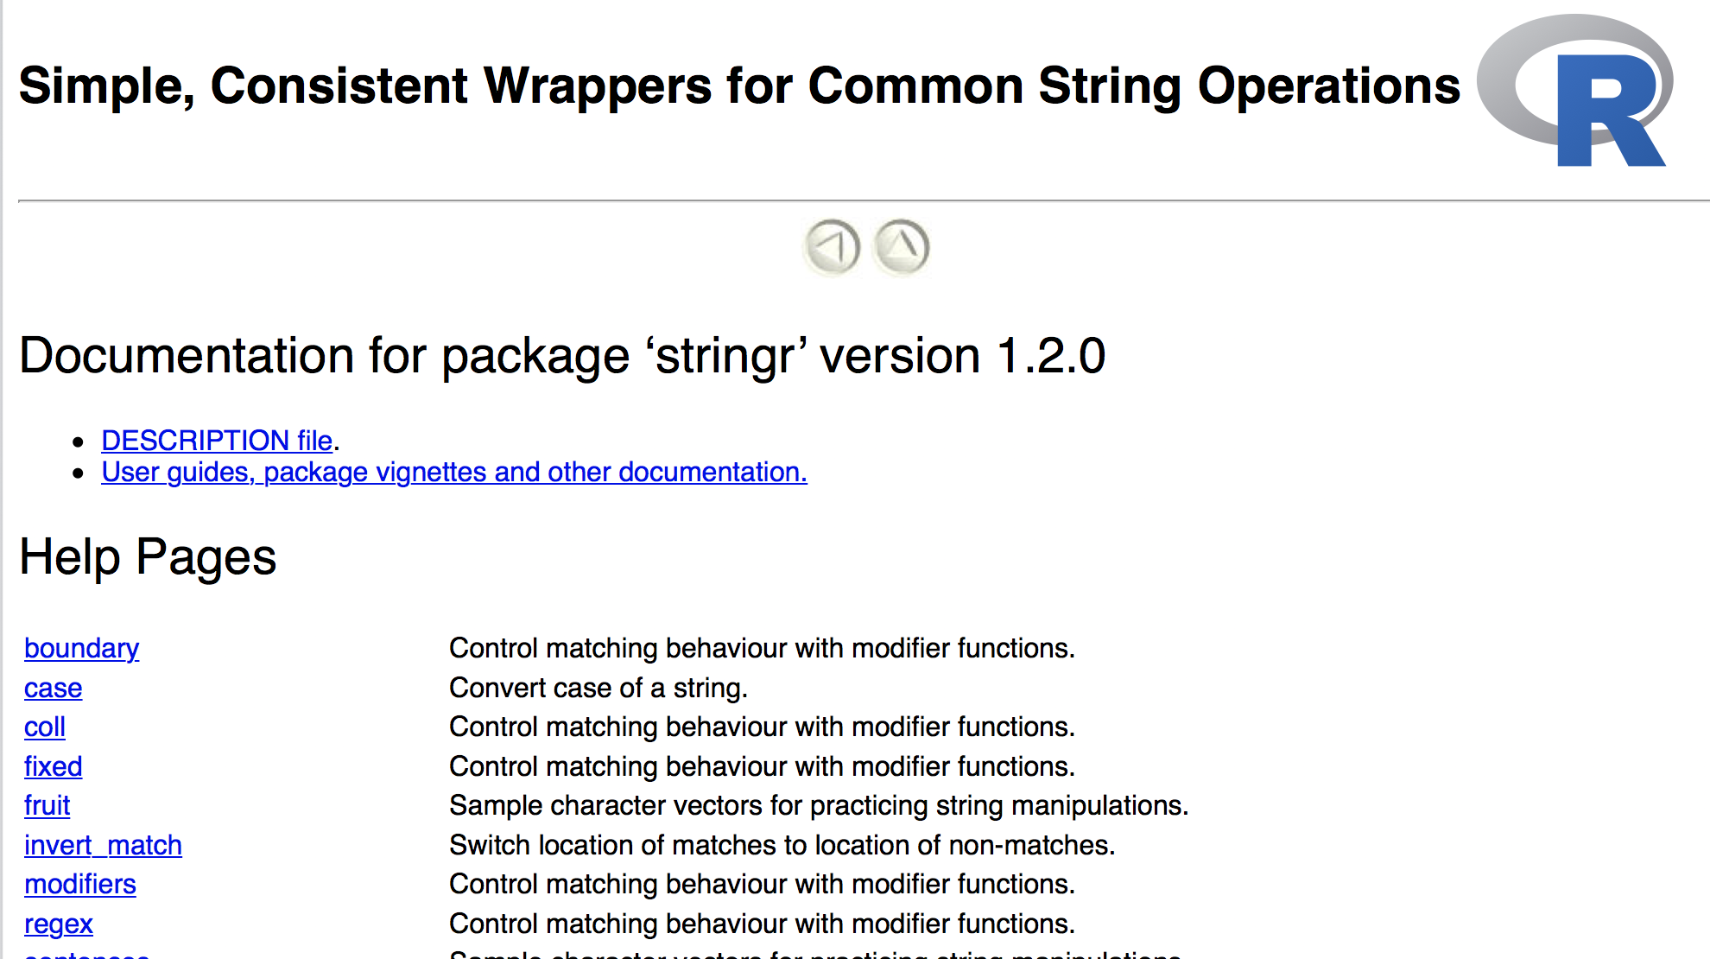
help(package = stringr)
CC BY-SA RStudio

Slide 40
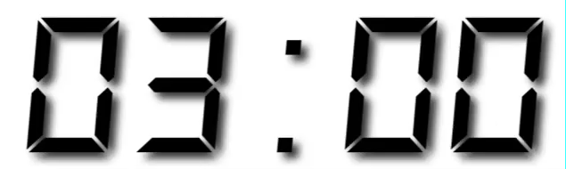
Your Turn
Run help(package = stringr) to open the help directory for stringr.
Read through the function descriptions and find the function that determines whether two strings match.
The first person in your group to find it wins!

Slide 41
str_detect()
Test whether a pattern appears within a string.
str_detect(string, pattern)
vector of strings to find patterns in
a string that represents a regular expression
CC BY-SA RStudio

Slide 42
Quiz
What will this return?
strings <- c("Apple", "Orange")
str_detect(strings, "pp")

Slide 43
Quiz
What will this return?
strings <- c("Apple", "Orange")
str_detect(strings, "pp")
TRUE FALSE

Slide 44
Quiz
What will this return?
strings <- c("Apple", "Pineapple")
str_detect(strings, "apple")

Slide 45
Quiz
What will this return?
strings <- c("Apple", "Pineapple")
str_detect(strings, "apple")
FALSE TRUE

Slide 46
Quiz
What will this return?
"AC\DC"

Slide 47
Quiz
What will this return?
"AC\DC"
Error: '\D' is an unrecognized escape in character string starting ""AC\D"

Slide 48
special characters
A backslash followed by one or more characters which stand for a special type of character.
Use writeLines() to see the characters represented by a string.
## Use an escape to include a special character
writeLines("\"")
## "
writeLines("\\")
## \
A string is not a
sequence of characters itself, but a representation of a sequence of characters
CC BY-SA RStudio

Slide 49
writeLines("AC\\DC")
## AC\DC
CC BY-SA RStudio

Slide 50
Quiz
What will this return?
str_detect("AC\\DC", "\\")

Slide 51
Quiz
What will this return?
str_detect("AC\\DC", "\\")
Error in stri_detect_regex(string, pattern, opts_regex = opts(pattern)) :
Unrecognized backslash escape sequence in pattern. (U_REGEX_BAD_ESCAPE_SEQUENCE)

Slide 52
regular expressions
regex is a "language" for describing a pattern of characters, with patterns of characters, e.g.
\w*[aeiouy]\b
writeLines("\w*[aeiouy]\b")
## ERROR" \w not a recognized special character
writeLines("\\w*[aeiouy]\\b")
## "\w*[aeiouy]\b"
CC BY-SA RStudio

Slide 53
writeLines("\\")
## \
This is not a valid regular expression
(looks like an incomplete special character)
CC BY-SA RStudio

Slide 54
We want to find this
\
…which is represented by this regex
\\
…which is represented by this string
Write your patterns at this level
"\\\\"
CC BY-SA RStudio

Slide 55
We want to find this
?
…which is represented by this regex
\
…which is represented by this string
"\\"
CC BY-SA RStudio

Slide 56
We want to find this
abc
…which is represented by this regex
abc
…which is represented by this string
"abc"
CC BY-SA RStudio

Slide 57
Your Turn
How many names end in a vowel anyways?
Winnow babynames to distinct names with:
babynames %>% distinct(name)
Use str_detect() to detect names that end in a vowel (pattern = "\\w*[aeiouy]\\b")
Calculate the number of names that end in a vowel

Slide 58
babynames %>%
distinct(name) %>%
mutate(vowel = str_detect(name, "\\w*[aeiouy]\\b")) %>%
summarise(n = n(), n_vowel = sum(vowel))
# A tibble: 1 × 2
n n_vowel
<int> <int>
1 93889 55324
CC BY-SA RStudio

Slide 59
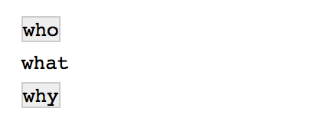
str_view()
Displays the matches of a regular expression in the Viewer pane
str_view(c("who", "what", "why"), "\\w*[aeiouy]\\b")
CC BY-SA RStudio

Slide 60
What is a date time exactly?
now <- Sys.time()
now
## "2017-01-01 00:00:01 EST"
typeof(now)
## "double"
print.default(now)
## [1] 1483246801
## attr(,"tzone")
## [1] "America/New_York"
## attr(,"class")
## [1] "POSIXct" "POSIXt"
atomic vector
(double)
augmented with attributes
(tzone, class)
CC BY-SA RStudio

Slide 61
A double that R treats in a special way
print
## function (x, ...)
## UseMethod("print")
## <bytecode: 0x10c1e1f50>
## <environment: namespace:base>
class(now)
## "POSIXct" "POSIXt"
print.POSIXct(now)
## "2017-01-01 00:00:01 EST"
find the method of print for the class of x
CC BY-SA RStudio

Slide 62
Augmented vector
An atomic vector augmented with attributes, including a class, which let’s R treat the contents in a specific way.
Access the attributes of an augmented vector with attributes() and attr()
attributes(now)
## $tzone
## [1] "America/New_York"
## $class
## [1] "POSIXct" "POSIXt"
attr(now, "tzone")
##"America/New_York"
CC BY-SA RStudio

Slide 63

Factors

Slide 64
factors
R’s representation of categorical data. Consists of:
A set of values
An ordered set of valid levels
eyes <- factor(x = c("blue", "green", "green"),
levels = c("blue", "brown", "green"))
eyes
## [1] blue green green
## Levels: blue brown green
CC BY-SA RStudio

Slide 65
factors
Stored as an integer vector with a levels attribute
unclass(eyes)
## 1 3 3
## attr(,"levels")
## "blue" "brown" "green"
CC BY-SA RStudio

Slide 66

forcats
Simple functions for working with factors.
# install.packages("tidyverse")
library(forcats)
CC BY-SA RStudio

Slide 67
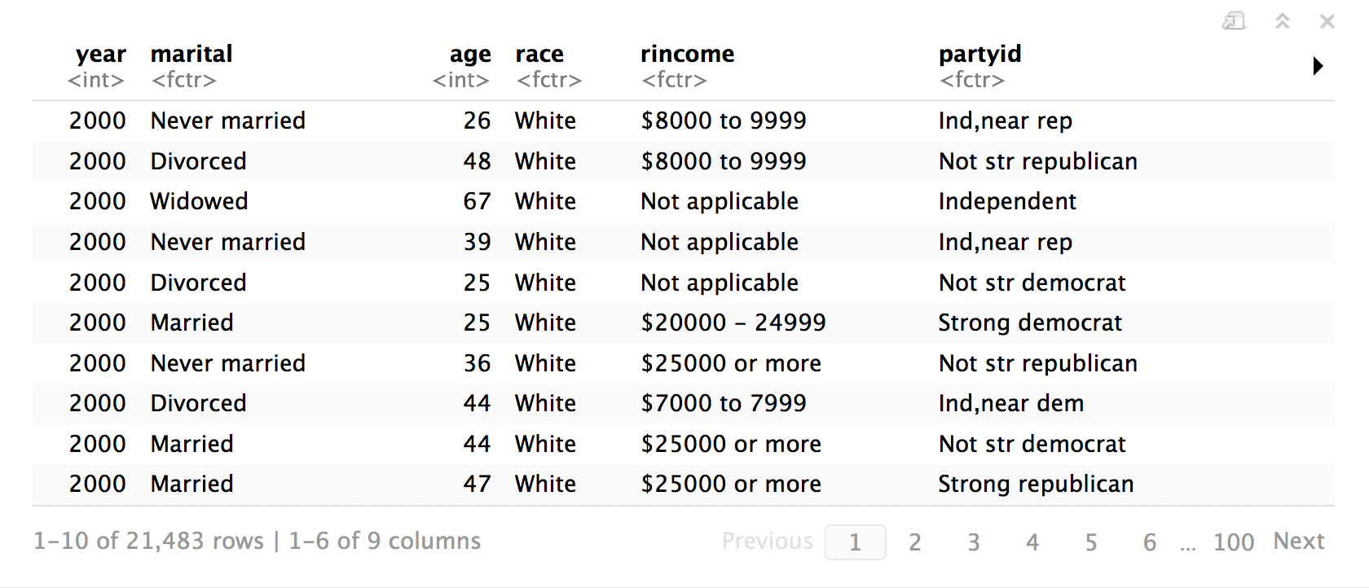
gss_cat
library(forcats)
gss_cat
A sample of data from the General Social Survey, a long-running US survey conducted by NORC at the University of Chicago.
CC BY-SA RStudio

Slide 68
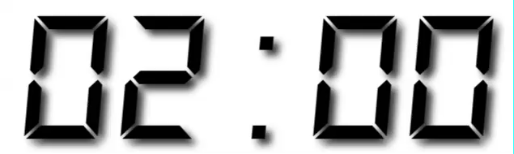
Warm Up
Decide in your group:
Which religions watch the least TV?
Do married people watch more or less TV than single people?

Slide 69
Which religions watch the least TV?
gss_cat %>%
drop_na(tvhours) %>%
group_by(relig) %>%
summarise(tvhours = mean(tvhours)) %>%
ggplot(aes(tvhours, relig)) +
geom_point()
CC BY-SA RStudio

Slide 70
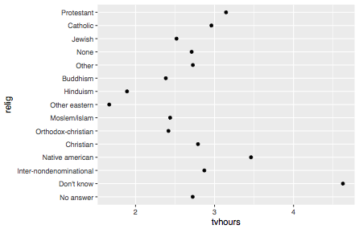
CC BY-SA RStudio

Slide 71
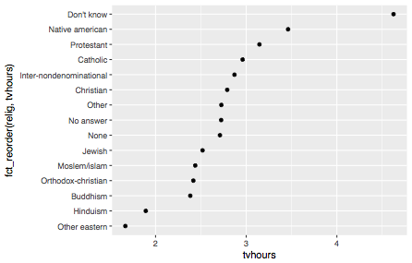
CC BY-SA RStudio

Slide 72
Why is the Y axis in this order?
CC BY-SA RStudio

Slide 73
levels()
Use levels() to access a factor’s levels
levels(gss_cat$relig)
## [1] "No answer" "Don't know"
## [3] "Inter-nondenominational" "Native american"
## [5] "Christian" "Orthodox-christian"
## [7] "Moslem/islam" "Other eastern"
## [9] "Hinduism" "Buddhism"
## [11] "Other" "None"
## [13] "Jewish" "Catholic"
## [15] "Protestant" "Not applicable"
CC BY-SA RStudio

Slide 74
Why is the Y axis in this order?
Because the
levels of relig have this order
CC BY-SA RStudio

Slide 75
Most useful skills
Reorder the levels
Recode the levels
Collapse levels
CC BY-SA RStudio

Slide 76
Reordering
levels

Slide 77
fct_reorder()
Reorders the levels of a factor based on the result of fun(x) applied to each group of cases (grouped by level).
fct_reorder(f, x, fun = median, …, .desc = FALSE)
factor to reorder
variable to reorder by
(in conjunction with fun)
function to reorder by
(in conjunction with x)
put in descending order?
CC BY-SA RStudio

Slide 78
gss_cat %>%
drop_na(tvhours) %>%
group_by(relig) %>%
summarise(tvhours = mean(tvhours)) %>%
ggplot(aes(tvhours, fct_reorder(relig, tvhours))) +
geom_point()
CC BY-SA RStudio

Slide 79
CC BY-SA RStudio

Slide 80
Your Turn 3
Repeat the previous exercise, some of whose code is in your notebook, to make a sensible graph of average TV consumption by marital status.

Slide 81
gss_cat %>%
drop_na(tvhours) %>%
group_by(marital) %>%
summarise(tvhours = mean(tvhours)) %>%
ggplot(aes(tvhours, fct_reorder(marital, tvhours))) +
geom_point()
CC BY-SA RStudio

Slide 82
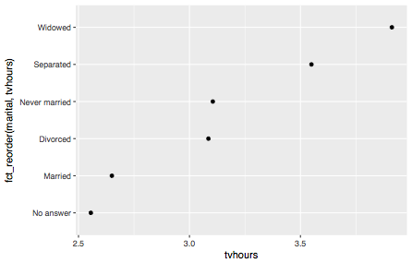
CC BY-SA RStudio

Slide 83
fct_reorder2()
Reorders the levels of a factor by the Y values associated with the largest X values.
fct_reorder2(f, x, y, fun = last2, …, .desc = FALSE)
X variable
Y variable
CC BY-SA RStudio

Slide 84
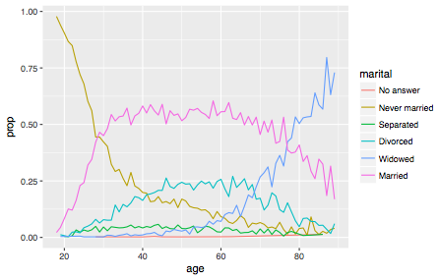
Proportion who report each marital status by age
CC BY-SA RStudio

Slide 85
gss_cat %>%
drop_na(age) %>%
group_by(age, marital) %>%
count() %>%
mutate(prop = n / sum(n)) %>%
ggplot(aes(age, prop, color = marital)) +
geom_line()
CC BY-SA RStudio

Slide 86
gss_cat %>%
drop_na(age) %>%
group_by(age, marital) %>%
count() %>%
mutate(prop = n / sum(n)) %>%
ggplot(aes(age, prop,
color = fct_reorder2(marital, age, prop)) +
geom_line()
CC BY-SA RStudio

Slide 87
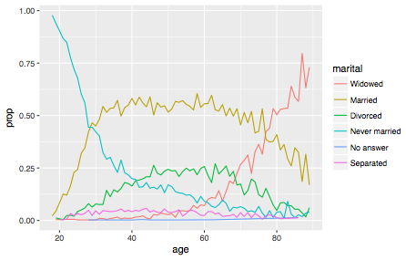
CC BY-SA RStudio

Slide 88
Similar reordering functions

Slide 89
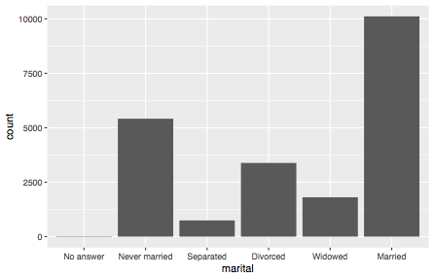
gss_cat %>%
ggplot(aes(marital)) + geom_bar()
CC BY-SA RStudio

Slide 90
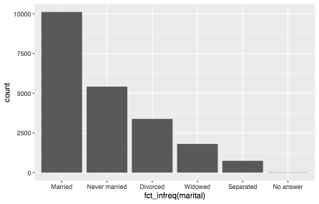
fct_infreq
gss_cat %>%
ggplot(aes(fct_infreq(marital))) + geom_bar()
CC BY-SA RStudio

Slide 91
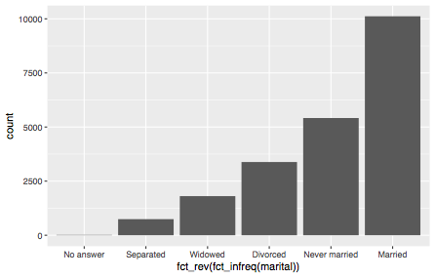
fct_rev
gss_cat %>%
ggplot(aes(fct_rev(fct_infreq(marital)))) + geom_bar()
CC BY-SA RStudio

Slide 92
Changing
level values

Slide 93
Your Turn 4
Do you think liberals or conservatives watch more TV?
Compute average tv hours by party ID an then plot the results.

Slide 94
gss_cat %>%
drop_na(tvhours) %>%
group_by(partyid) %>%
summarise(tvhours = mean(tvhours)) %>%
ggplot(aes(tvhours, fct_reorder(partyid, tvhours))) +
geom_point() +
labs(y = "partyid")
CC BY-SA RStudio

Slide 95
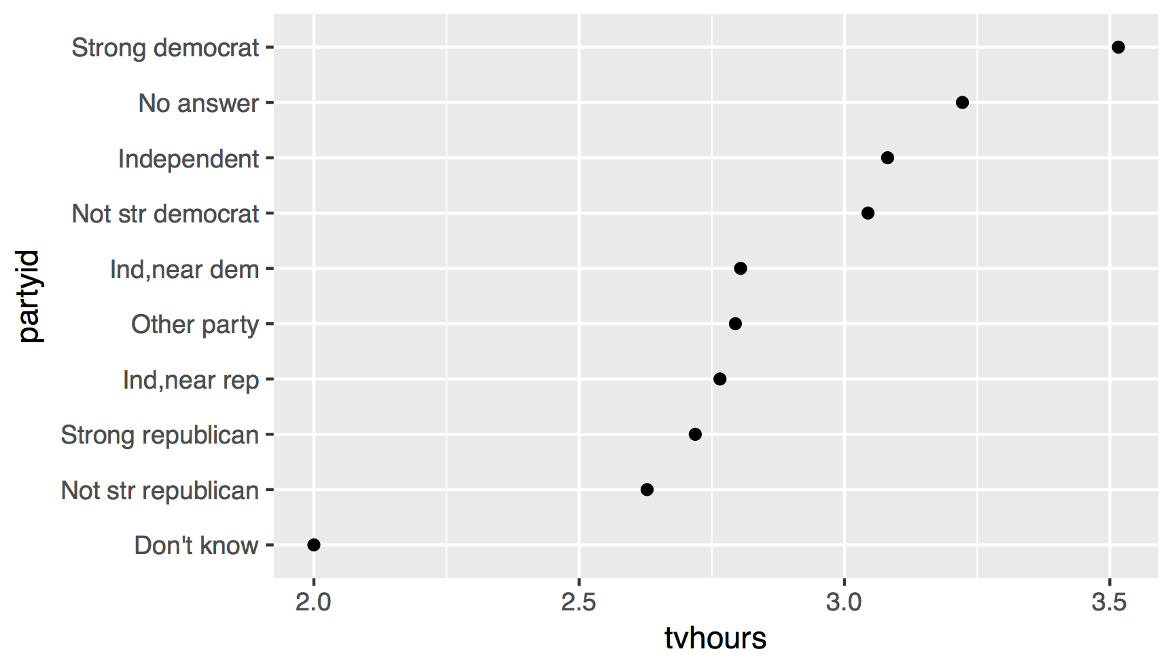
1. How can we improve these labels?
CC BY-SA RStudio

Slide 96
fct_recode()
Changes values of levels
fct_recode(f, …)
factor with levels
new level = old level pairs (as a named character vector)
CC BY-SA RStudio

Slide 97
gss_cat %>%
drop_na(tvhours) %>%
mutate(partyid = fct_recode(partyid,
"Republican, strong" = "Strong republican",
"Republican, weak" = "Not str republican",
"Independent, near rep" = "Ind,near rep",
"Independent, near dem" = "Ind,near dem",
"Democrat, weak" = "Not str democrat",
"Democrat, strong" = "Strong democrat")) %>%
group_by(partyid) %>%
summarise(tvhours = mean(tvhours)) %>%
ggplot(aes(tvhours, fct_reorder(partyid, tvhours))) +
geom_point() + labs(y = "partyid")
CC BY-SA RStudio

Slide 98
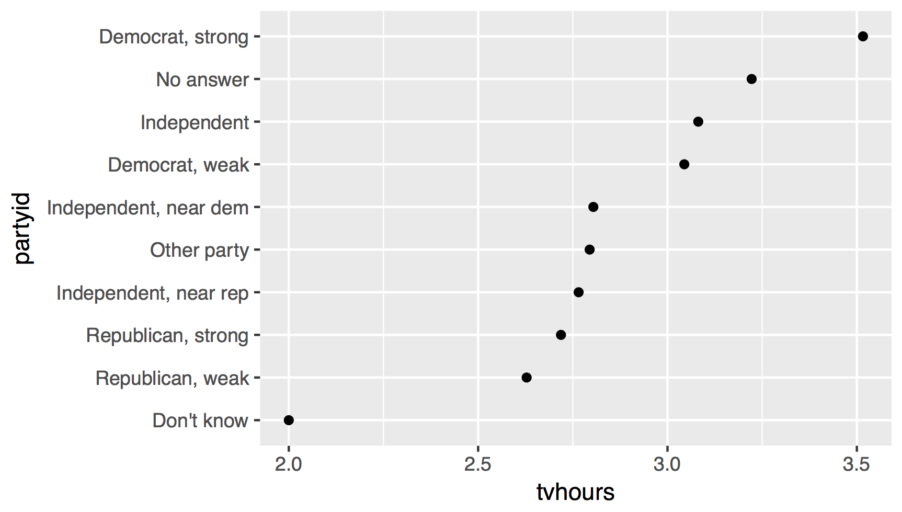
liberal
liberal
liberal
conservative
2. How can we combine these groups?
conservative
conservative
CC BY-SA RStudio

Slide 99
Collapsing
levels

Slide 100
fct_collapse()
Changes multiple levels into single levels
fct_collapse(f, …)
factor with levels
named arguments set to a character vector (levels in the vector will be collapsed to the name of the argument)
CC BY-SA RStudio

Slide 101
gss_cat %>%
drop_na(tvhours) %>%
mutate(partyid = fct_collapse(partyid,
conservative = c("Strong republican",
"Not str republican",
"Ind,near rep"),
liberal = c("Strong democrat",
"Not str democrat",
"Ind,near dem"))) %>%
group_by(partyid) %>%
summarise(tvhours = mean(tvhours)) %>%
ggplot(aes(tvhours, fct_reorder(partyid, tvhours))) +
geom_point() + labs(y = "partyid")
CC BY-SA RStudio

Slide 102
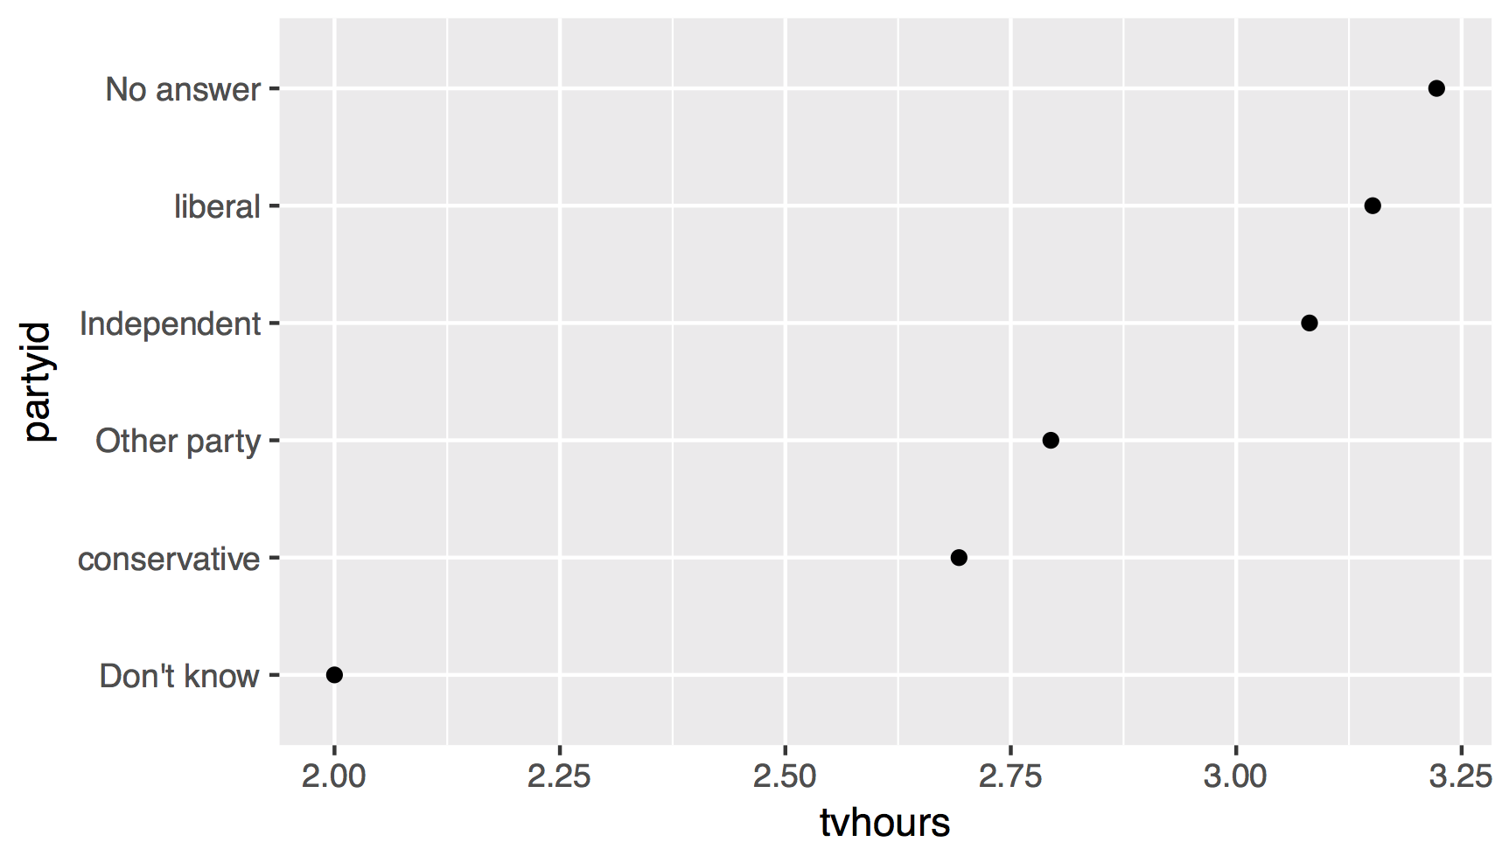
There are relatively few points in each of these groups
CC BY-SA RStudio

Slide 103
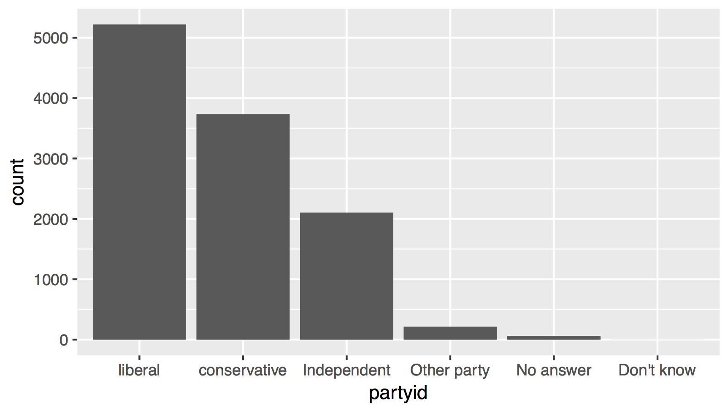
CC BY-SA RStudio

Slide 104
fct_lump()
Collapses levels with fewest values into a single level. By default collapses as many levels as possible such that the new level is still the smallest.
fct_lump(f, other_level = "Other", …)
factor with levels
name of new level
CC BY-SA RStudio

Slide 105
gss_cat %>%
drop_na(tvhours) %>%
mutate(partyid = partyid %>%
fct_collapse(
conservative = c("Strong republican",
"Not str republican", "Ind,near rep"),
liberal = c("Strong democrat", "Not str democrat",
"Ind,near dem")) %>%
fct_lump()
) %>%
group_by(partyid) %>%
summarise(tvhours = mean(tvhours)) %>%
ggplot(aes(tvhours, fct_reorder(partyid, tvhours))) +
geom_point() + labs(y = "partyid")
CC BY-SA RStudio

Slide 106
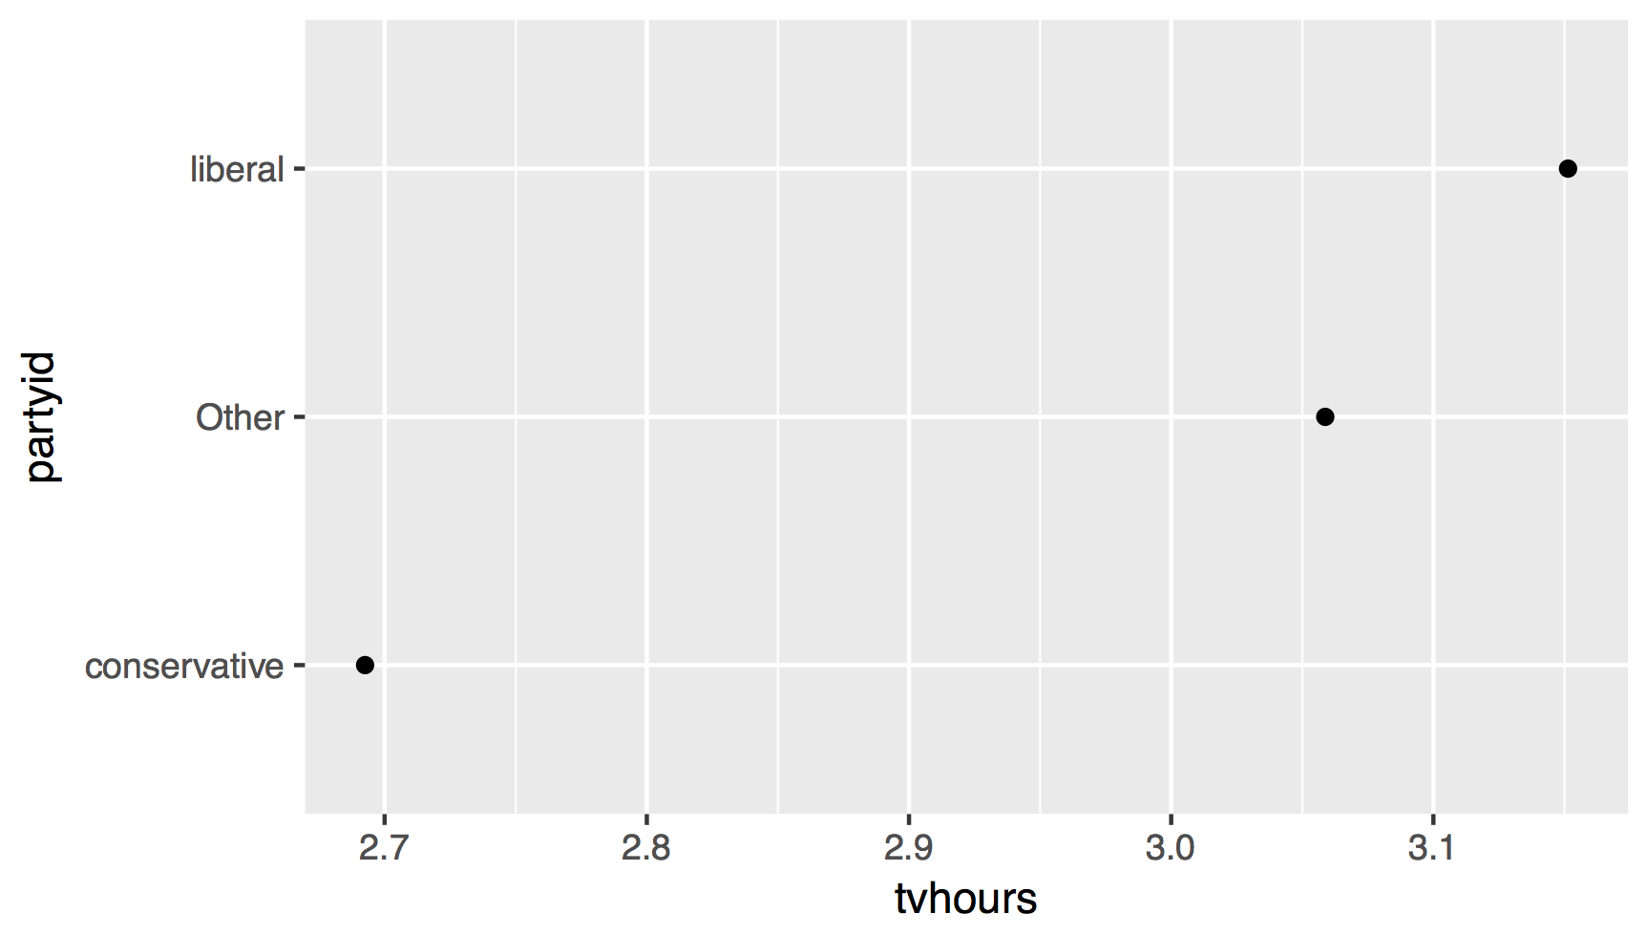
CC BY-SA RStudio

Slide 107
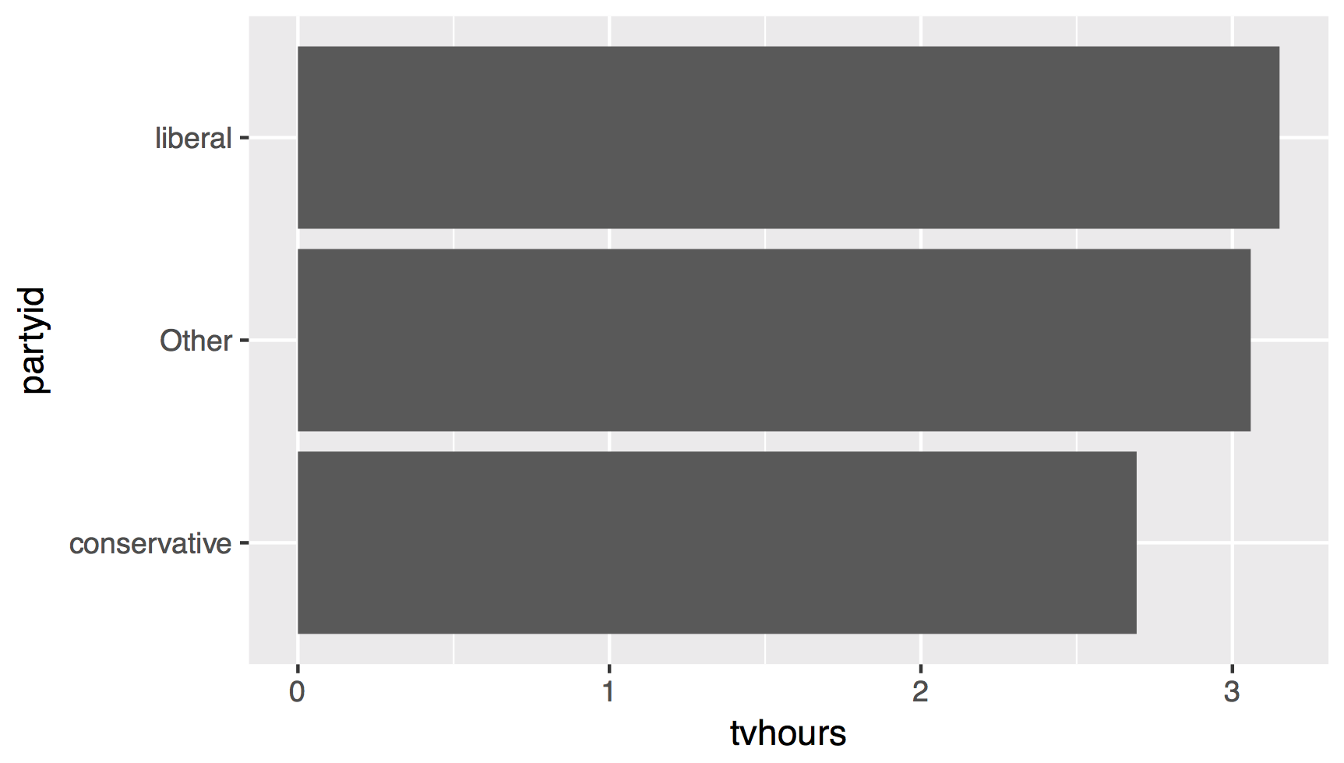
CC BY-SA RStudio

Slide 108
gss_cat %>%
drop_na(tvhours) %>%
mutate(partyid = partyid %>%
fct_collapse(
conservative = c("Strong republican",
"Not str republican", "Ind,near rep"),
liberal = c("Strong democrat", "Not str democrat",
"Ind,near dem")) %>%
fct_lump()
) %>%
group_by(partyid) %>%
summarise(tvhours = mean(tvhours)) %>%
ggplot(aes(fct_reorder(partyid, tvhours), tvhours)) +
geom_col() + labs(x = "partyid") + coord_flip()
CC BY-SA RStudio

Slide 109
Date times

Slide 110
Quiz
Does every year have 365 days?

Slide 111
Quiz
Does every day have 24 hours?

Slide 112
Quiz
Does every minute have 60 seconds?

Slide 113
Quiz
What does a month measure?

Slide 114

Dates and times involve:
instants - specific moments in time (e.g., Jan 1, 2017)
time spans - spans of time (e.g., a day)
CC BY-SA RStudio

Slide 115
Most useful skills
Creating dates/times (i.e. parsing)
Access and change parts of a date
Deal with time zones
Do math with instants and time spans
CC BY-SA RStudio

Slide 116
Warm Up
Decide in your group:
What is the best time of day to fly?
What is the best day of the week to fly?

Slide 117
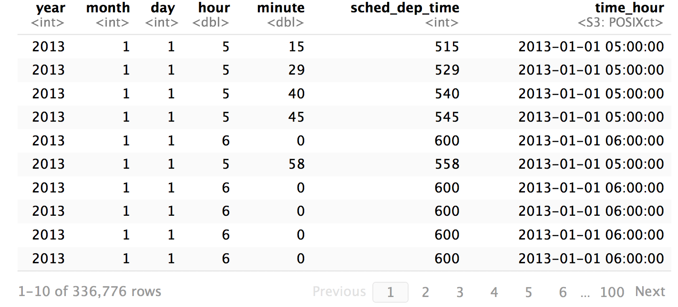
flights %>% select(c(1, 2, 3, 17, 18, 5, 19))
CC BY-SA RStudio

Slide 118
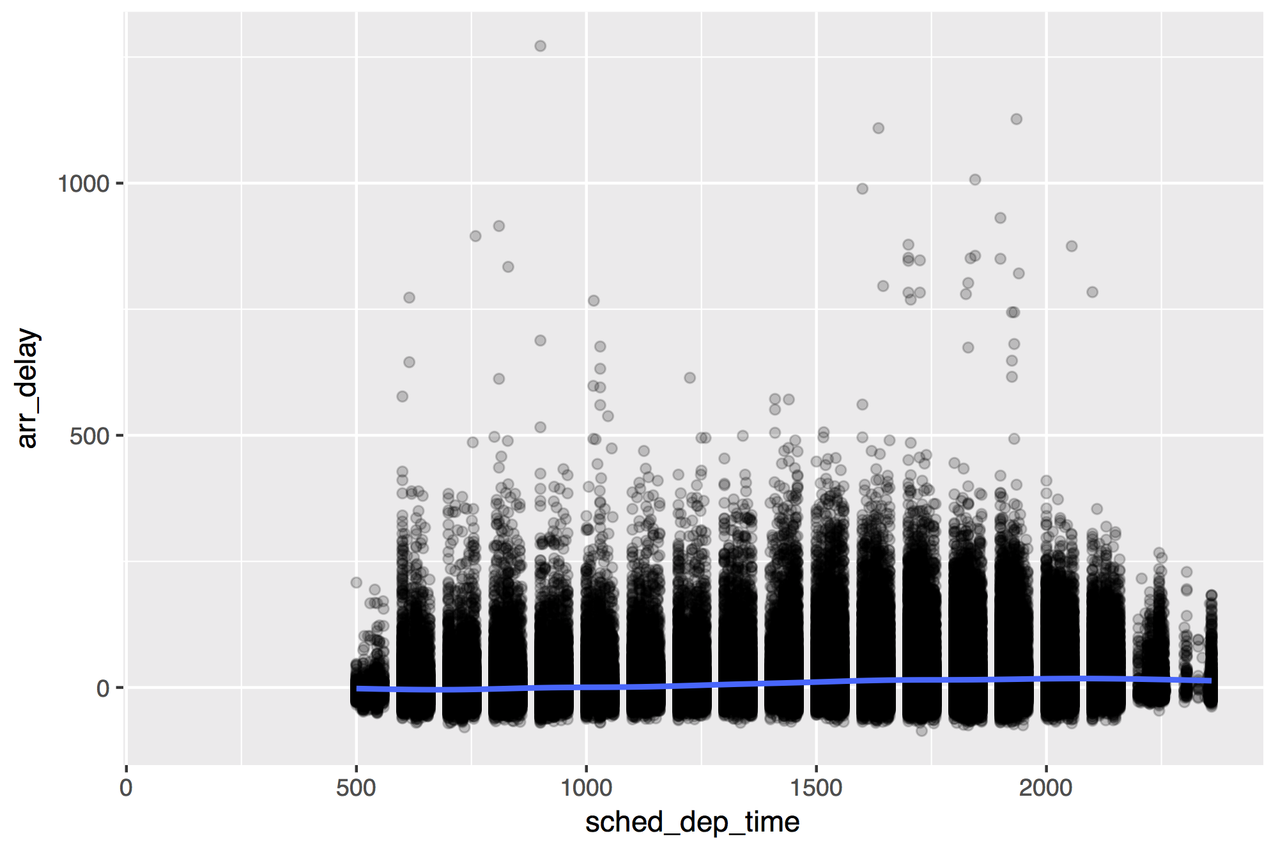
flights %>%
ggplot(mapping = aes(x = sched_dep_time, y = arr_delay)) +
geom_point(alpha = 0.2) + geom_smooth()
CC BY-SA RStudio

Slide 119
flights %>% select(c(1, 2, 3, 17, 18, 5, 19))
CC BY-SA RStudio

Slide 120
Creating dates
and times

Slide 121
(some of) R’s instant classes
2017-01-01 12:34:56
CC BY-SA RStudio

Slide 122
POSIXct
2017-01-01 12:34:56
Stored as the number of seconds since 1970-01-01 00:00:00
Sys.time()
## "2017-01-01 12:34:56 EST"
unclass(Sys.time())
## 1483292096
CC BY-SA RStudio

Slide 123
Dates
2017-01-01 12:34:56
Stored as the number of days since 1970-01-01
Sys.Date()
## "2017-01-01"
unclass(Sys.Date())
## 17167
CC BY-SA RStudio

Slide 124

hms
A class for representing just clock times.
# install.packages("tidyverse")
library(hms)
CC BY-SA RStudio

Slide 125
hms
2017-01-01 12:34:56
Stored as the number of seconds since 00:00:00.*
library(hms)
hms(seconds = 56, min = 34, hour = 12)
## 12:34:56
unclass(hms(56, 34, 12))
## 45296
CC BY-SA RStudio
* on a typical day

Slide 126
hms()
2017-01-01 12:34:56
library(hms)
hms(seconds, minutes, hours, days)
CC BY-SA RStudio
* on a typical day

Slide 127
Your Turn 5
What is the best time of day to fly?
Use the hour and minute variables in flights to compute the time of day for each flight as an hms. Then use a smooth line to plot the relationship between time of day and arr_delay.

Slide 128
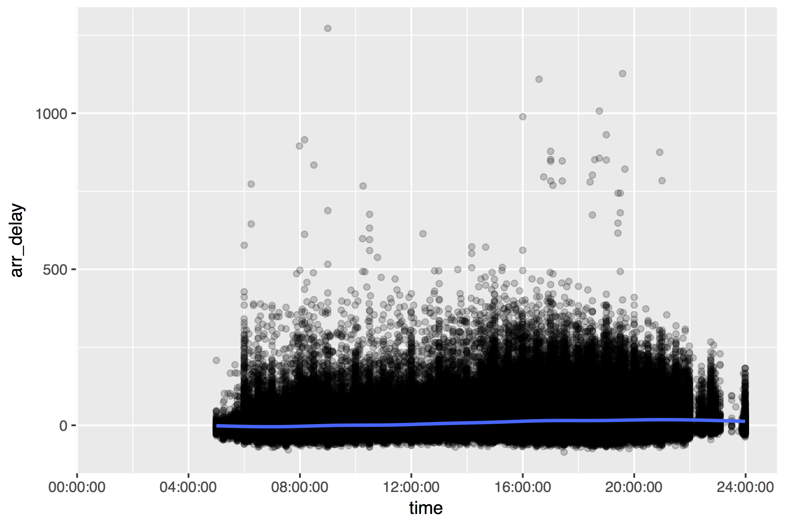
flights %>%
mutate(time = hms(hour = hour, minute = minute)) %>%
ggplot(aes(time, arr_delay)) +
geom_point(alpha = 0.2) + geom_smooth()
CC BY-SA RStudio

Slide 129
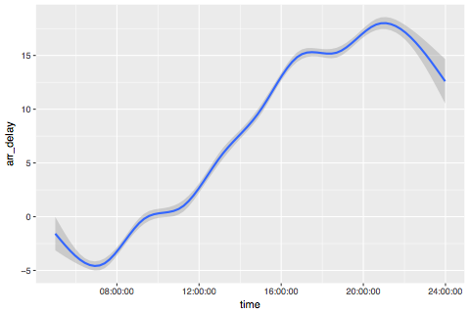
CC BY-SA RStudio

Slide 130
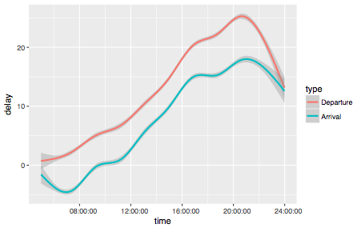
CC BY-SA RStudio

Slide 131
Challenge
Work as a group to modify your code to make the previous graph. You will need to:
Select just the time, arr_delay, and dep_delay variables
Gather the arr_delay and dep_delay columns into a key:value column pair names type and delay
Recode the delay column to contain "Departure" and "Arrival" values
Reorder the type column (which is a factor) by the time and "value" column.

Slide 132
flights %>%
mutate(time = hms::hms(hour = hour, minute = minute)) %>%
select(time, arr_delay, dep_delay) %>%
gather("type", "delay", 2:3) %>%
mutate(type = fct_recode(type,
"Arrival" = "arr_delay", "Departure" = "dep_delay"),
type = fct_reorder2(type, time, delay)) %>%
ggplot(aes(time, delay, color = type)) + geom_smooth()
CC BY-SA RStudio

Slide 133
lubridate
Functions for working with dates and time spans
# install.packages("tidyverse")
library(lubridate)
CC BY-SA RStudio

Slide 134
ymd() family
To parse strings as dates, use a y, m, d, h, m, s combo
ymd("2017/01/11")
mdy("January 11, 2017")
ymd_hms("2017-01-11 01:30:55")
CC BY-SA RStudio

Slide 135
Parsing functions
function | parses to
ymd_hms(), ymd_hm(), ymd_h()
ydm_hms(), ydm_hm(), ydm_h() | POSIXct
dmy_hms(), dmy_hm(), dmy_h()
mdy_hms(), mdy_hm(), mdy_h()
ymd(), ydm(), mdy() | Date (POSIXct if tz specified)
myd(), dmy(), dym(), yq()
hms(), hm(), ms() | Period
CC BY-SA RStudio

Slide 136
ymd() family
To parse strings as dates, use a y, m, d, h, m, s combo
ymd_hms("2017-01-01T12:34:56")
## "2017-01-01 12:34:56 UTC"
ymd_hm("2017/01/01 12:34")
## "2017-01-01 12:34:56 UTC"
dmy("2 January 17")
## "2017-01-02"
ms("34 56")
## "34M 56S"
lubridate functions are separator agnostic
CC BY-SA RStudio

Slide 137
Accessing
and changing components

Slide 138
Accessing components
Extract components by name with a singular name
date <- ymd("2017-01-11")
year(date)
## 2017
CC BY-SA RStudio

Slide 139
Setting components
Use the same function to set components
date
## "2017-01-11"
year(date) <- 1999
date
## "1999-01-11"
CC BY-SA RStudio

Slide 140
Accessing date time components
function | extracts | extra arguments
year() | year
month() | month | label = FALSE, abbr = TRUE
week() | week
day() | day of month
wday() | day of week | label = FALSE, abbr = TRUE
qday() | day of quarter
yday() | day of year
hour() | hour
minute() | minute
second() | second
CC BY-SA RStudio

Slide 141
Accessing components
wday(ymd("2017-01-11"))
## 3
wday(ymd("2017-01-11"), label = TRUE)
## [1] Wed
## 7 Levels: Sun < Mon < Tues < Wed < Thurs < ... < Sat
wday(ymd("2017-01-11"), label = TRUE, abbr = FALSE)
## [1] Sunday
## 7 Levels: Sunday < Monday < Tuesday < ... < Saturday
CC BY-SA RStudio

Slide 142
Your Turn 6
Fill in the blanks to:
Extract the day of the week of each flight (as a full name) from time_hour.
Calculate the average arr_delay by day of the week.
Plot the results as a column chart (bar chart) with geom_col().

Slide 143
flights %>%
mutate(weekday = wday(time_hour, label = TRUE, abbr = FALSE)) %>%
group_by(weekday) %>%
drop_na(arr_delay) %>%
summarise(avg_delay = mean(arr_delay)) %>%
ggplot() +
geom_col(mapping = aes(x = weekday, y = avg_delay))
CC BY-SA RStudio

Slide 144
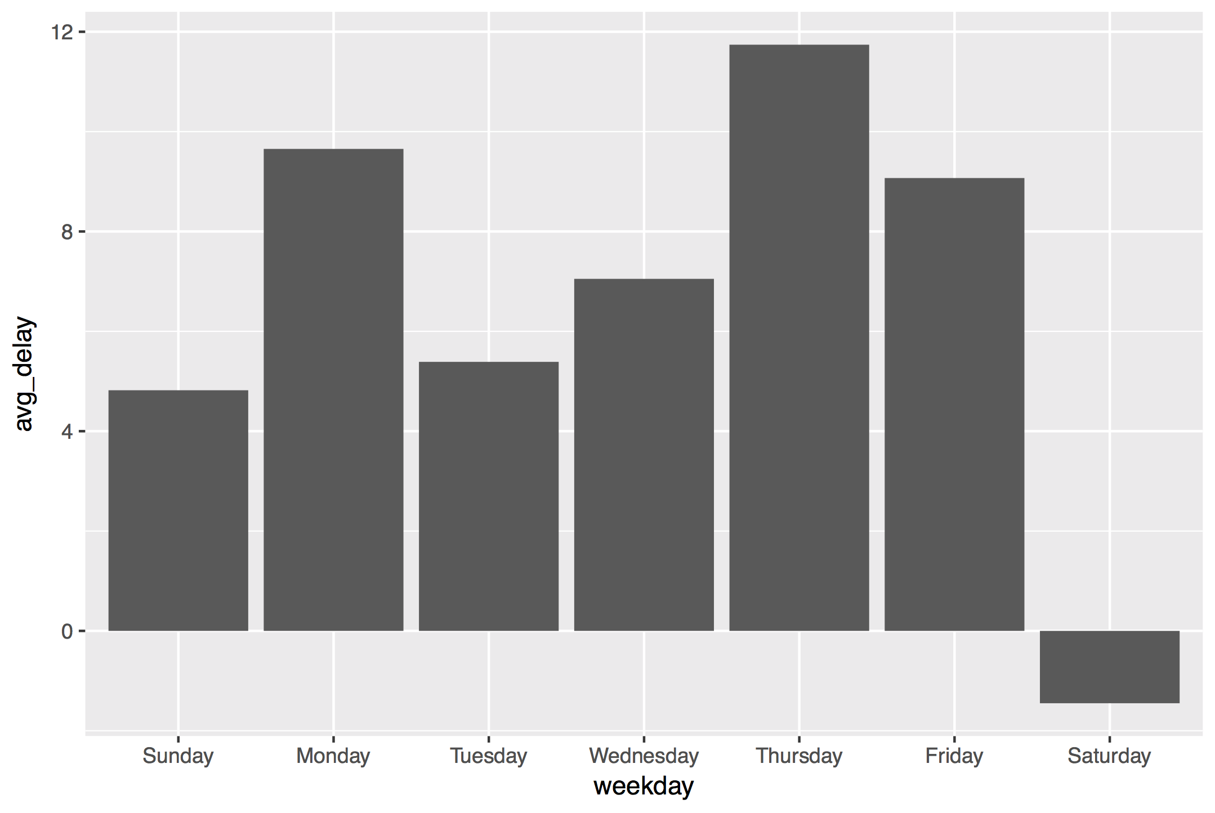
CC BY-SA RStudio

Slide 145
Parsing functions
function | parses to
ymd_hms(), ymd_hm(), ymd_h()
ydm_hms(), ydm_hm(), ydm_h() | POSIXct
dmy_hms(), dmy_hm(), dmy_h()
mdy_hms(), mdy_hm(), mdy_h()
ymd(), ydm(), mdy() | Date (POSIXct if tz specified)
myd(), dmy(), dym(), yq()
hms(), hm(), ms() | Period
CC BY-SA RStudio

Slide 146
Parsing functions
function | parses to
ymd_hms(), ymd_hm(), ymd_h()
ydm_hms(), ydm_hm(), ydm_h() | POSIXct
dmy_hms(), dmy_hm(), dmy_h()
mdy_hms(), mdy_hm(), mdy_h()
ymd(), ydm(), mdy() | Date (POSIXct if tz specified)
myd(), dmy(), dym(), yq()
hms(), hm(), ms() | Period
Same name as
hms() in hms
CC BY-SA RStudio

Slide 147
hms::hms()
package name
function name
CC BY-SA RStudio
* on a typical day

Slide 148
hms::hms()
lubridate::hms()
CC BY-SA RStudio
* on a typical day

Slide 149
hms()
hms::hms(seconds = 3, hours = 5)
Use the
hms() function in the hms package
CC BY-SA RStudio
* on a typical day

Slide 150
Dealing with time zones

Slide 151
Quiz
How many time zones are there?

Slide 152
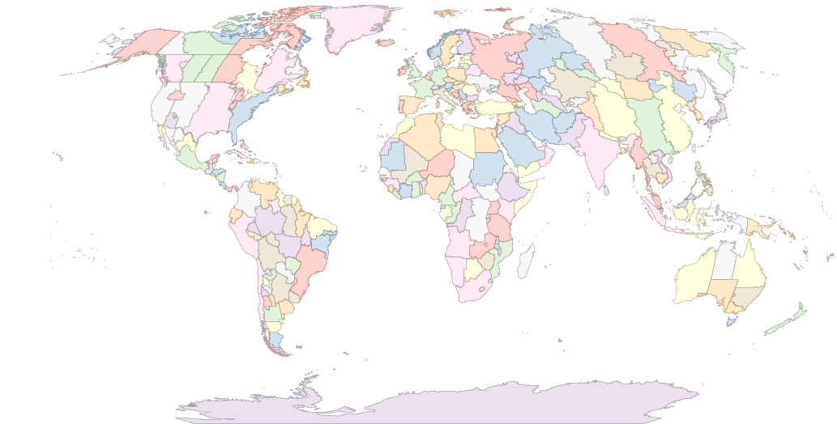
589
CC BY-SA RStudio

Slide 153
Time zone names
OlsonNames()
## "Africa/Abidjan"
## "Africa/Accra"
## "Africa/Addis_Ababa"
## "Africa/Algiers"
## "Africa/Asmara"
## …
## 589 total
CC BY-SA RStudio

Slide 154
Quiz
What is the "benchmark" time zone?

Slide 155
Quiz
What is the "benchmark" time zone?
GMT?
UTC

Slide 156
ymd() family
Lubridate functions use UTC by default
ymd_hms(…, tz = "UTC")
CC BY-SA RStudio

Slide 157
Quiz
nyc <- now(tz = "America/New_York")
la <- now(tz = "America/Los_Angeles")
coasts <- c(nyc, la)
What is the time zone of coasts?

Slide 158
!
R stores time zones as an attribute, which means that:
every datetime in a vector must share the same time zone
time zones are frequently dropped
CC BY-SA RStudio

Slide 159
Quiz
What time should this return? Decide in your group.
nyc <- ymd_hms("2017-01-01 00:00:00",
tz = "America/New_York")
tz(nyc) <- "America/Los_Angeles"

Slide 160
with_tz()
Creates same instant with the new display
with_tz(t,
tz = "America/Denver")
## "2017-01-05 02:00:00 MST"
with_tz(t,
tz = "America/Chicago")
## "2017-01-05 03:00:00 CST"
t <- now(
tz = "America/Los_Angeles")
## "2017-01-05 01:00:00 PST"
with_tz(t,
tz = "America/New_York")
## "2017-01-05 04:00:00
CC BY-SA RStudio

Slide 161
force_tz()
Creates same instant with the new display
force_tz(t,
tz = "America/Denver")
## "2017-01-05 01:00:00
force_tz(t,
tz = "America/Chicago")
## "2017-01-05 01:00:00
t <- now(
tz = "America/Los_Angeles")
## "2017-01-05 01:00:00 PST"
force_tz(t,
tz = "America/New_York")
## "2017-01-05 01:00:00
CC BY-SA RStudio

Slide 162
Your Turn
this_instant <- now()
What time is it in Honolulu (Pacific/Honolulu) this instant?
What will it be here when Honolulu clocks show our time?
The time_hour column of flights is saved as UTC. Convert it to the correct time zone for New York City. Notice that the hours element of time_hour already matches flights$hour, which is ostensibly the correct hour in the America/New_York time zone.

Slide 163
this_instant %>%
with_tz("Pacific/Honolulu")
this_instant %>%
force_tz("Pacific/Honolulu") %>%
with_tz("America/New_York")
flights %>%
mutate(time_hour = with_tz(time_hour, "America/New_York")) %>%
select(time_hour)
CC BY-SA RStudio

Slide 164
Doing math with dates and times

Slide 165
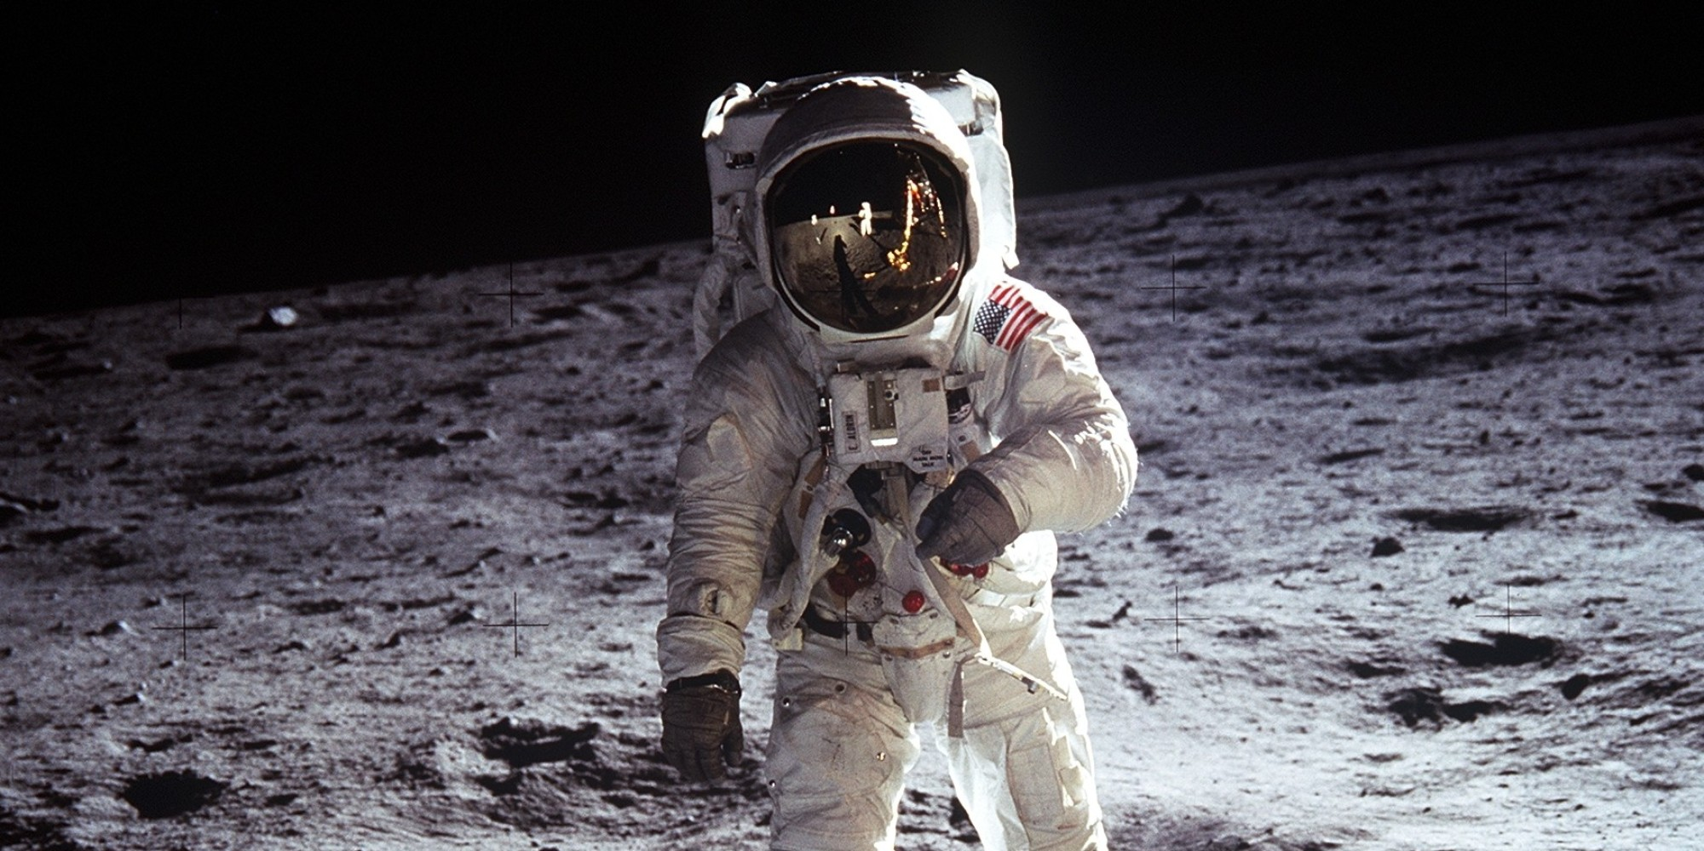
July, 20 1969
CC BY-SA RStudio

Slide 166

Nov, 25 1992
CC BY-SA RStudio

Slide 167
difftimes
When you subtract two dates in R you get a difftime
now() - as.POSIXct(today())
## Time difference of 22.29285 hours
But difftimes use inconsistent units (sometimes weeks, days, hours, minutes, or seconds…)
CC BY-SA RStudio

Slide 168
durations
A time span that is always measured in seconds
as.duration(today() - aladdin)
## "761011200s (~24.11 years)"
as.duration(aladdin - moon_landing)
## "736905600s (~23.35 years)"
Plus, a better display
CC BY-SA RStudio

Slide 169
Math with dates
To do math with dates add and subtract periods
weeks(1) - days(3) + hours(2)
## "4d 2H 0M 0S"
date + months(0:11)
## "2017-01-01" "2017-02-01" "2017-03-01"
## "2017-04-01" "2017-05-01" "2017-06-01"
## "2017-07-01" "2017-08-01" "2017-09-01"
## "2017-10-01" "2017-11-01" "2017-12-01"
CC BY-SA RStudio

Slide 170
Period constructors
function | makes
years(x) | x years
months(x) | x months
weeks(x) | x weeks
days(x) | x days
hours(x) | x hours
minutes(x) | x minutes
seconds(x) | x seconds
milliseconds(x) | x milliseconds
microseconds(x) | x microseconds
nanoseconds(x) | x nanoseconds
picoseconds(x) | x picoseconds
CC BY-SA RStudio

Slide 171
Quiz
What might worry us here?
march_11 + days(1)
## "2016-03-12 08:00:00 EST"
march_12 + days(1)
## "2016-03-13 08:00:00 EDT"

Slide 172
periods
A time span that is measured in clock units
march_11 + days(1)
## "2016-03-12 08:00:00 EST"
march_12 + days(1)
## "2016-03-13 08:00:00 EDT"
CC BY-SA RStudio

Slide 173
durations
If absolute time matters, use seconds or a duration
march_11 + ddays(1)
## "2016-03-12 08:00:00 EST"
march_12 + ddays(1)
## "2016-03-13 09:00:00 EDT"
CC BY-SA RStudio

Slide 174
Duration constructors
function | makes
dyears(x) | x years
dweeks(x) | x weeks
ddays(x) | x days
dhours(x) | x hours
dminutes(x) | x minutes
dseconds(x) | x seconds
dmilliseconds(x) | x milliseconds
dmicroseconds(x) | x microseconds
dnanoseconds(x) | x nanoseconds
dpicoseconds(x) | x picoseconds
CC BY-SA RStudio

Slide 175
Quiz
What should this return? Decide in your group.
months(1) / days(1)

Slide 176
Math with periods
months(1) / days(1)
## estimate only: convert to intervals for accuracy
## 30.4375
CC BY-SA RStudio

Slide 177
Quiz
Can we calculate something like this accurately?
"The month between Jan 1, 2017 and Feb 1, 2017" /days(1)

Slide 178
intervals
A time span that is measured by start and end dates
interval(mdy("Jan 1, 2017"), mdy("Feb 1, 2017"))
## 2017-01-01 UTC--2017-02-01 UTC
mdy("Jan 1, 2017") %--% mdy("Feb 1, 2017")
## 2017-01-01 UTC--2017-02-01 UTC
CC BY-SA RStudio

Slide 179
Divide by periods and durations to compute the length
month1 <- mdy("Jan 1, 2017") %--% mdy("Feb 1, 2017")
month1 / days(1)
## 31
CC BY-SA RStudio

Slide 180
Working with intervals
function | makes
int_start() | access or change the start date
int_end() | access or change the end date
int_diff() | intervals between dates in a vector
int_length() | number of seconds in the interval
int_flip() | switches start and end dates of th interval
int_shift() | shifts an interval by a time span
int_standardize() | flips interval is length is negative
int_aligns(x) | tests whether interval begin or end on same instant
int_overlaps() | tests whether intervals overlap
intersect(), union(), setdiff() | set operations for intervals
%within% | tests whether instants fall within an interval
CC BY-SA RStudio

Slide 181
%within%
Tests whether instants fall within an interval
firsts <- ymd("2017-01-01") + months(0:11)
summer <- ymd("2017-06-21") %--% ymd("2017-09-21")
firsts %within% summer
## FALSE FALSE FALSE FALSE FALSE FALSE
## TRUE TRUE TRUE FALSE FALSE FALSE
CC BY-SA RStudio

Slide 182
Your Turn
Are flight delays worse over the holidays?
NYC Public Schools held winter recess from December 23, 2013 to January 1, 2014. Create an interval that captures the recess.
Complete the code below to plot delays over time during recess vs. the rest of the year
flights %>%
mutate(during_recess = _____________________________,
time = hms::hms(hour = hour, minute = minute)) %>%
ggplot(aes(time, dep_delay, color = during_recess)) +
geom_smooth()

Slide 183
recess <- ymd("2013-12-23") %--% ymd("2014-01-01")
flights %>%
mutate(during_recess = time_hour %within% recess,
time = hms::hms(hour = hour, minute = minute)) %>%
ggplot(aes(time, dep_delay, color = during_recess)) +
geom_smooth()
CC BY-SA RStudio

Slide 184
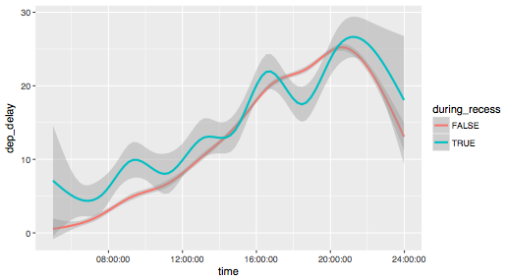
CC BY-SA RStudio

Slide 185
Math with instants
Instant
Time span
Instant
Instant
Time span
?
CC BY-SA RStudio

